Slide 1

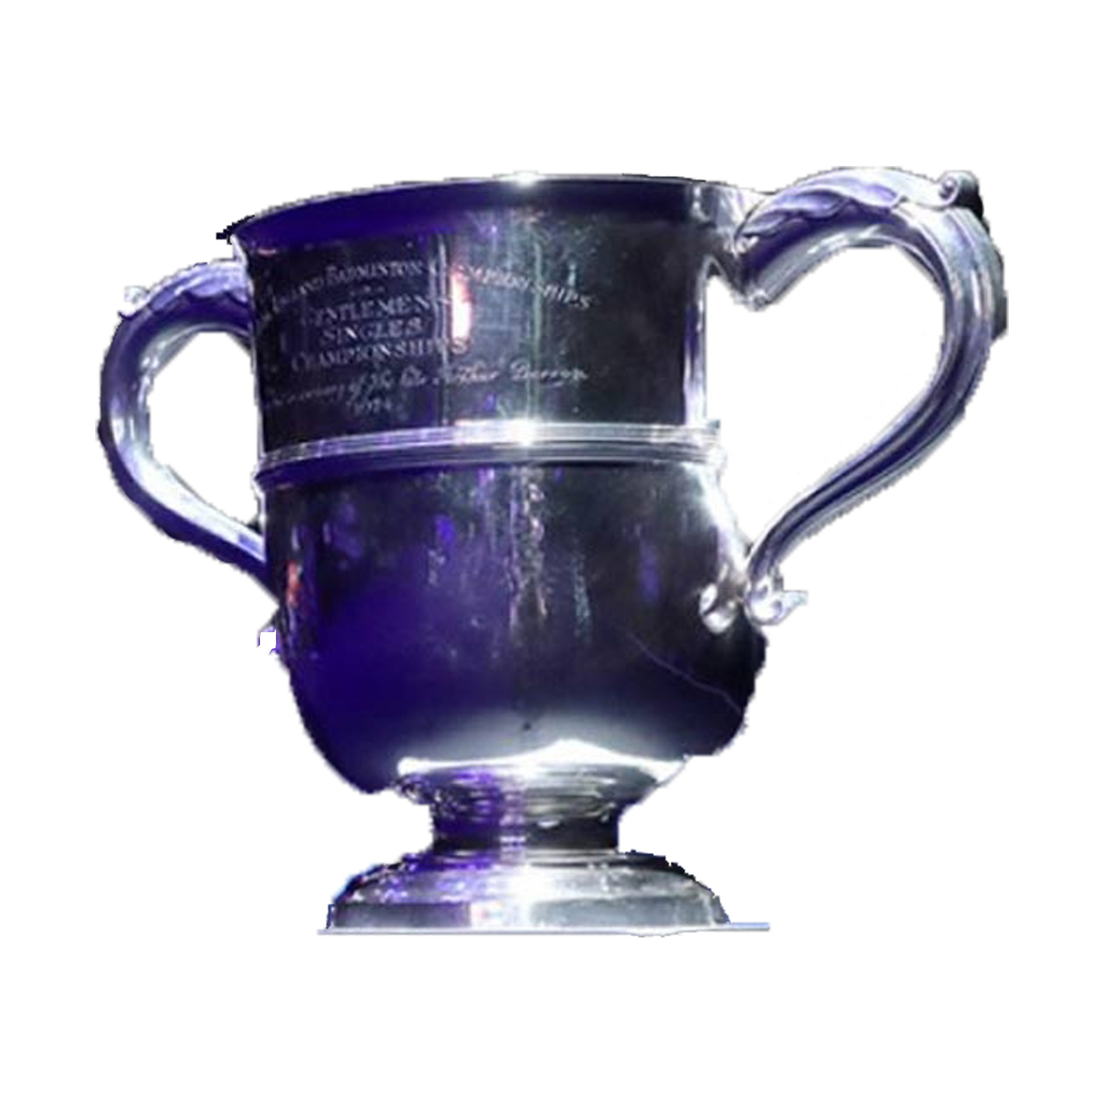


















All England
Winning Country Composition
Additional Trivia
37
Participating
Nationalities/Regions
32
9
6
% final matches
went rubber
28
% titles won
by World #1
3
2
20
5
3
1
1
Avg. Total Rallies at Finals
Duration Span at Finals (mins)
3 Times Winners
WS
TAI Tzu Ying
2017, 2018, 2020
MS
LEE Chong Wei
2011, 2014, 2017
WD
Wang/Yu
2011, 2013, 2011
XD
Ahmad/Natsir
2012, 2013, 2014
MS: Men’s Singles WS: Women’s Singles
MD: Men’s Doubles WD: Women’s Doubles XD: Mixed Doubles
Tournaments are from 2011 until All England 2020

Slide 2

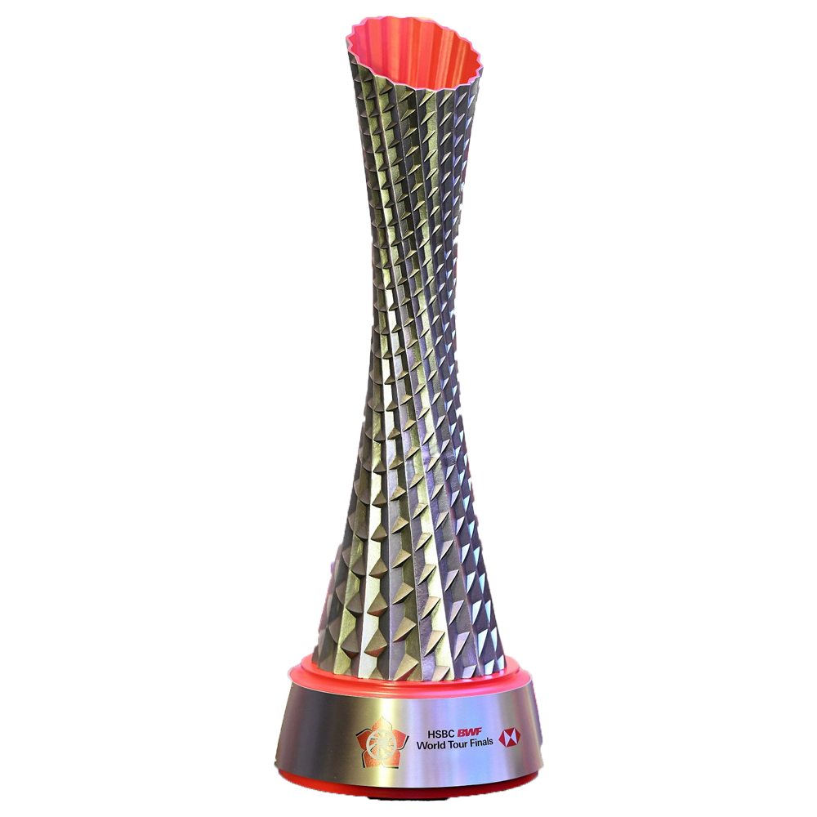


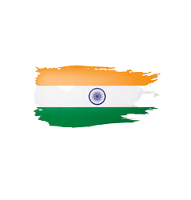






BWF World Tour/World Superseries Finals
Winning Country Composition
Additional Trivia
21
Participating
Nationalities/Regions
26
% final matches
went rubber
8
7
38
% titles won
by World #1
2
1
4
Different countries of Tournaments Location
23
4
3
1
1
Avg. Total Rallies at Finals
Duration Span at Finals (mins)
3 Times Winners
MD
Ahsan/Setiawan
2013, 2015, 2019
MD
Boe/Mogensen
2011, 2012, 2013
WD
Wang/Yu
2011, 2012, 2013
XD
Zhang/Zhao
2010, 2011, 2013
MS: Men’s Singles WS: Women’s Singles
MD: Men’s Doubles WD: Women’s Doubles XD: Mixed Doubles
BWF World Tour: 2018-2019
World Superseries Finals: 2010-2017
Tournaments are from 2010 until All England 2020

Slide 3









World Championships
Winning Country Composition
Additional Trivia
66
Participating
Nationalities/Regions
2
% final matches
went rubber
5
5
28
% titles won
by World #1
1
1
7
Different countries of Tournaments Location
23
3
1
1
Avg. Total Rallies at Finals
Duration Span at Finals (mins)
3 Times Winners
MD
Ahsan/Setiawan
2013, 2015, 2019
WS
Carolina MARIN
2014, 2015, 2018
XD
Zhang/Zhao
2011, 2014, 2015
MS: Men’s Singles WS: Women’s Singles
MD: Men’s Doubles WD: Women’s Doubles XD: Mixed Doubles
Tournaments are from 2010 until All England 2020
No World Championships Tournament in 2012 and 2016

